Slide 1

How Different Factors Drive Students’ Educational Performance
GT DSA – Project 1
Julia Cheng, Donterrius Daniels, Corban Doran, Sidney Henry, Hazel Morris, Tiera Nixon, Harsh Patel, Aaron Winfrey

Slide 2


MOTIVATION AND SUMMARY
Students of today encounter a variety of factors that can impact performance. We looked at a few factors students face and how they could potentially influence success outcomes
2

Slide 3






QUESTIONS and REASONS for ASKING THEM…
Family together
Does the cohabitation status of the students’ parents influence rate of failure?
Split parents correlate with many other factors. We wanted to know if that factor has an impact here.
In the Age of Tech
Does a students’ access to internet service hinder or help their success in school?
Access to technology is increasingly important in our world. Is it important to good grades?
Quality of Family Relationships
Do the students' relationships with their families, ranked from 1- Very Bad to 5- Excellent correlate to their grades?
Family life can add stress or support for a student. We wanted to know if this would correlate with grades.
To Study or Not to Study
How does length of study time compare to grades received?
We wanted to how much study time matters. Also, is there such a thing as too much study, and diminishing returns?
Alcohol Consumption
Does amount of alcohol consumed influence students' overall grade?
Alcohol can affect memory and learning ability. Will that affect student grades as well?
3

Slide 4



Question #1: Home Life
Does the cohabitation status of parents correlate with student failures?
By looking at the cohabitation status of each of the students’ set of parents, we can gain some insight
We examined the number of failures of students, compared to the two cohabitation statuses:
Together and Apart.
We looked at no failures, one failure, two failures, and three failures
For analysis purposes, we combined 2 failures and 3 failures into "multiple failures"
4

Slide 5
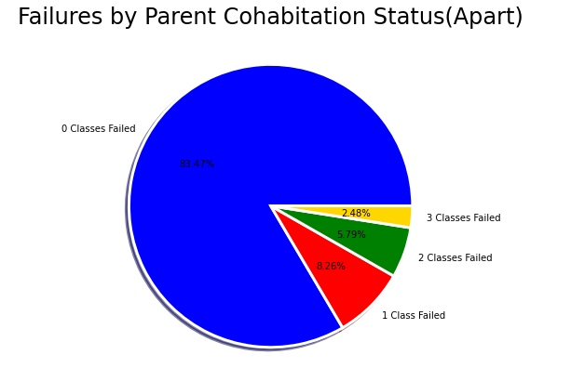
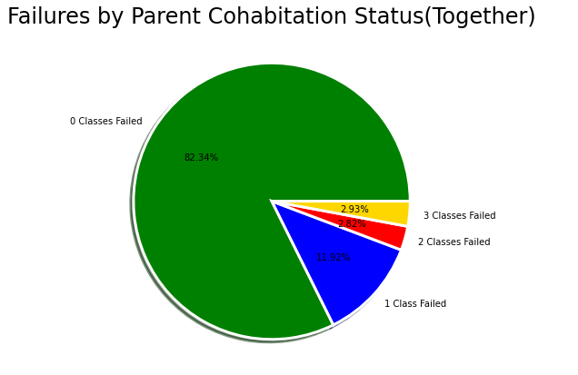
QUESTION #1 Visualization

Slide 6
We determined that there is not a meaningful correlation between the parent cohabitation status (whether parents are together or apart) and number of classes failed
For households with parents who are together, 5.75% of students failed more than one class. This is significantly lower than households with parents who are apart, where 8.27% of students failed more than one class
However, we see the opposite trend when examining students who failed 1 class. For "together" households, 11.92% of students failed 1 class, which is significantly more than the 8.26% of students from "apart" households
These conflicting findings, paired with a similar overall pass percentage, show that there is no meaningful correlation

Slide 7

Question #2: In the Age of Tech
Does a students’ access to internet service hinder or help their success in school?
We converted the grades from a 20-point scale to the standard US grading scale for ease of understanding
We grouped the grades by internet access - yes and no
7

Slide 8
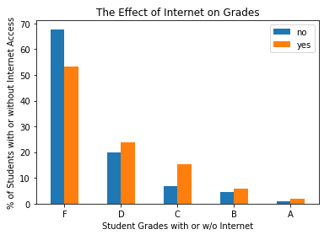
QUESTION #2 Visualization
Students with & without Internet vs Grades
Initially, the results did not appear significant
We determined the percentage differences between the percentages of students with and without internet who earned specific grades. For analysis purposes, we combined A's and B's into "good grades," C's and D's into "pass with ok grades," and F's as "fail"
Students with internet access are 39.94% more likely to earn a "good grade", 46.12% more likely to "pass with ok grades," and 21.46% less likely to "fail"

Slide 9

Question #3: To Study or Not(Less) to Study
How does length of study time compare to grades earned?
We again converted the 20-point grading scale to standard US metrics
We averaged the resulting grades for each student
We grouped students by hours of study and examined their corresponding grades
9

Slide 10
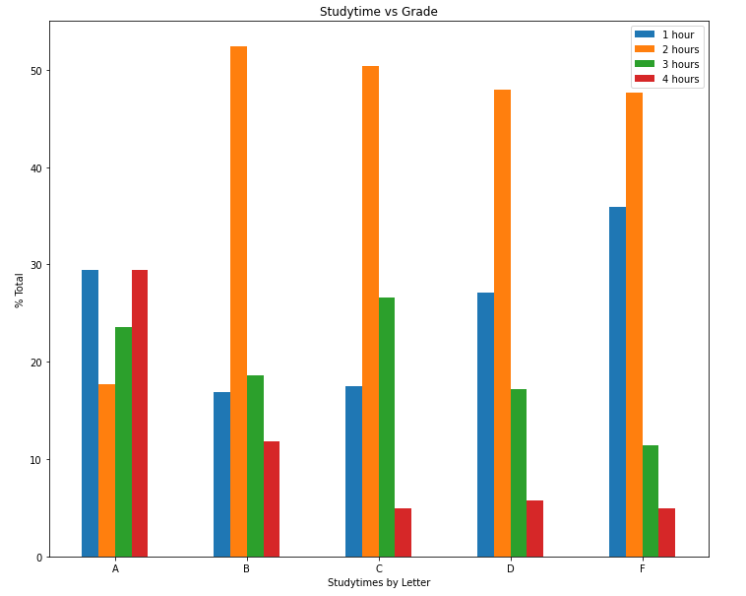
QUESTION #3 Visualization
Study time vs Grade
When we examined the data, we noticed the largest differences in the A's and F's
Almost no students who studied 3-4 hours failed
The vast majority of students who failed studied 1-2 hours
Students who earned A's studied a comparatively even amount of times
We dug deeper into the data for more meaning

Slide 11
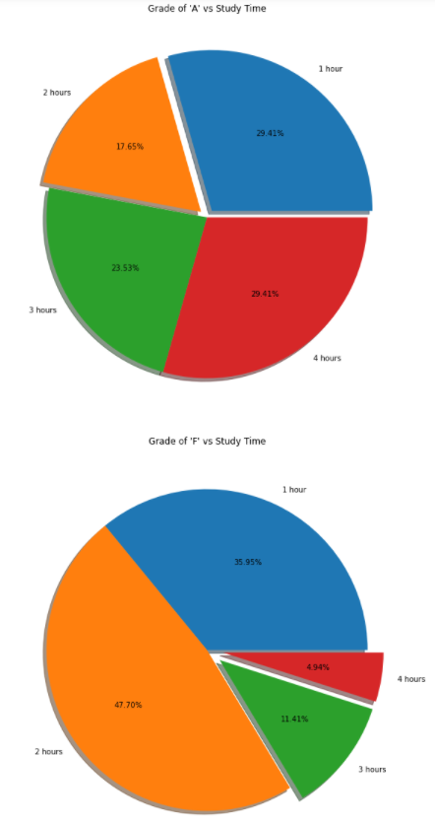
QUESTION #3 Visualization
A's and F's
When we compared the study times across the two groups, A's and F's, we found additional meaning
Students who studied 4 hours are 496% more likely to get an A than an F (percentage-wise)
Students who studied 3 hours are 106% more likely to get an A than an F (percentage-wise)
Students who studied 2 hours are 170% more likely to get an F than an A (percentage-wise)
Students who studied 1 hour are 22% more likely to get an F than an A (percentage-wise)
We speculated that this small difference could hint at some students who had mastered the material studying a small amount. This is something we could investigate further in the future
Grade of ‘A’ vs Study Time
Grade of ‘A’ vs Study Time

Slide 12

Question #4: Alcohol Consumption
Does the time in which alcohol is consumed influence students' overall grade?
We averaged weekend and weekday alcohol usage into total usage
Students ranked their usage from 1-5
We averaged the student's grades after converting from the 20 Point scale to the US standard 100 Point scale
12

Slide 13
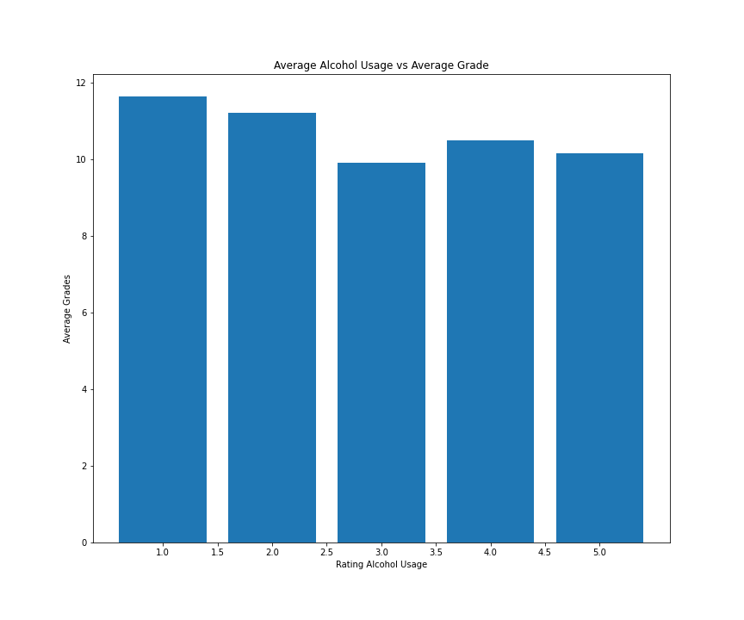
QUESTION #4 Visualization
Average Alcohol Usage vs Average Grade
There is a slight correlation between higher alcohol consumption and lower grades
We were surprised that there was not a stronger correlation, as we hypothesized that students drinking frequently throughout the week would have an adverse effect on grades earned

Slide 14


Question #5:
W
Do the students' relationships with their families, ranked from 1- Very Bad to 5- Excellent correlate to their grades?
We averaged the grades and converted them to the standard US 100 Point scale
Students ranked the quality of their relationships with their families, from 1-5
We combined and averaged all the grades earned for each relationship quality ranking
14

Slide 15
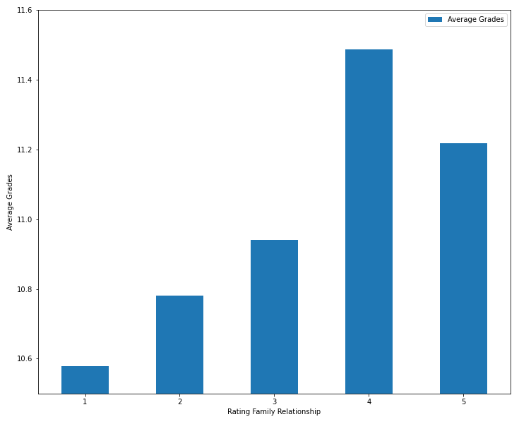
QUESTION #5 Visualization
Average Grade vs
Rating Family Relationship
There is a slight correlation between quality of family relationships and grades earned
We altered the scaled to make the relationship more apparent
We suspect that the visualization is someone flattened as it shows a collected and averaged series of averages

Slide 16

CLEANUP, EXPLORATION, AND ANALYSIS
Data(csv files) were gathered from the UCI Machine Learning Repository. The data was separated into two datasets. Therefore, the csv files had to be merged continuously
The data was gathered from two schools in Portugal, with grades in the subject areas of Math and Portuguese
It was not anticipated that we would not have the ability to create certain graphs from the data. Graphs like scatter plots and line graphs were not ideal because our data did not involve a time variable
After exploring the data, we quickly realized that additional columns were needed in order to help tell our story. For example, grading periods were separated into three columns and a column was created by averaging those three columns and then added to the initial data frame
16

Slide 17

DISCUSSION
We discovered that a variety of factors have positive and negative correlations with student grades:
There was no significant correlation between parental cohabitation and number of student failures
We found a significant relationship between internet access and student success. Internet access could signify other socio-economic factors which impact performance. This is something to investigate in the future
We found that higher study times corresponded with an increased likelihood to obtain an A or B, and that lower study times corresponded with an increased likelihood to fail
Student alcohol consumption was slightly correlated with lower grades
Quality of family relationships was slightly correlated with higher grades
We were surprised that internet connectivity mattered more than many other areas. Study time, unsurprisingly, was strongly correlated to performance
17

Slide 18


POSTMORTEM
Sometimes, it was initially unclear what story the data was telling us. Through group discussion and further analysis, we were able to unearth meaningful stories
We would have liked more time to compare factors. For example, does taking extra coursework correlate to higher grades? Does the parent's education level? Which one has a stronger correlation and by how much?
18

Slide 19

Thank You.... Questions?
References
Our data came from the UCI Machine Learning Repository.
Source: P. Cortez and A. Silva. Using Data Mining to Predict Secondary School Student Performance. In A. Brito and J. Teixeira Eds., Proceedings of 5th Future Business Technology Conference (FUBUTEC 2008) pp. 5-12, Porto, Portugal, April 2008, EUROSIS, ISBN 978-9077381-39-7.

